Slide 1
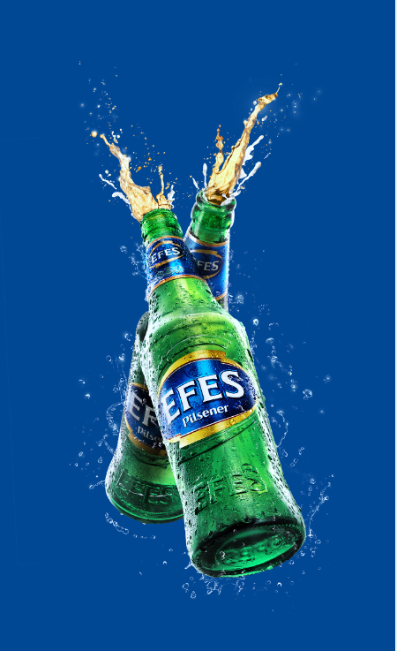

BEVERAGE GROUP

Slide 2
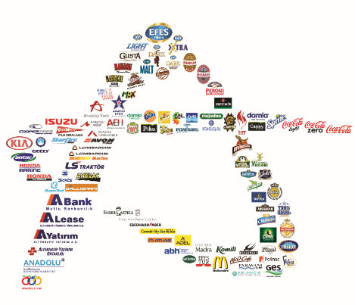
ANADOLU GROUP
Anadolu Efes is a subsidiary of Anadolu Group. Anadolu Group founded in 1950’s is one of Turkey’s biggest conglomerates with 87 companies in 19 countries from the Atlantic to the Pacific, including Turkey.
Anadolu Group operates in beverages, automotive, finance, retail, informatics, electronics, energy, food, real-estate and health care sectors.

Slide 3
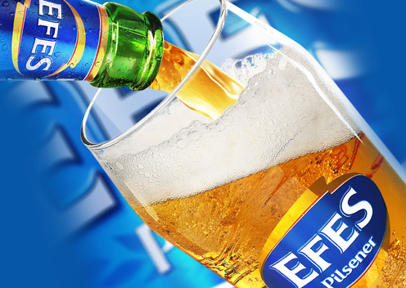
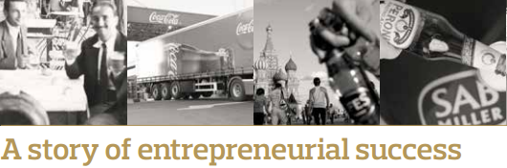
ANADOLU EFES
Anadolu Efes, a beer producer and a non-alcoholic beverage producer-bottler, with operations in a wide geography that covers Turkey, Russia, CIS countries, Europe, Central Asia and Middle East is continuing its journey to become a global company.
Today, Anadolu Efes has a brand portfolio of 46 brands,
18 beer processing facilities consisting of 5 in Turkey, 8 in Russia, 2 in Kazakhstan and one in Moldova, Ukraine and Georgia, along with 7 malt and 1 hop factories.
In 2012, Seeking to become major international player by building upon its solid competitive position in operational markets, Anadolu Efes further strengthened its regional presence through a strategic partnership with SABMiller.

Slide 4
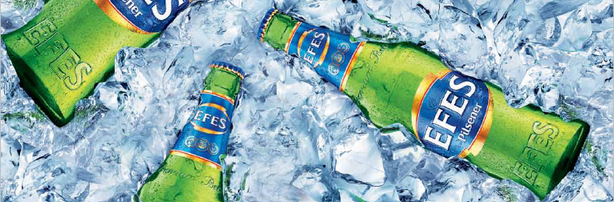
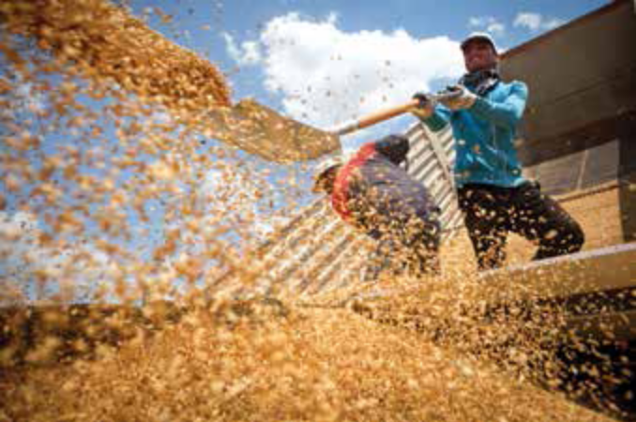

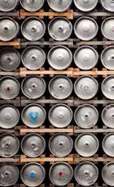
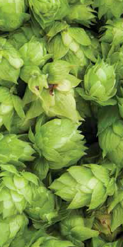

MISSION AND VISION
Vision: To become the most admired beer company in the countries where we operate.
Mission: We help people enjoy life better through the responsible enjoyment of our products

Slide 5
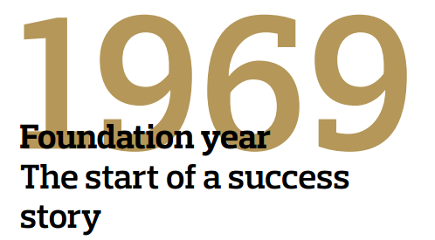

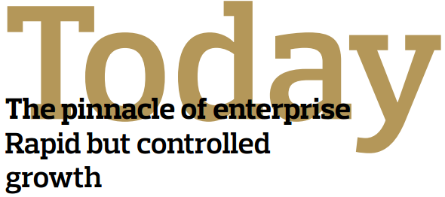
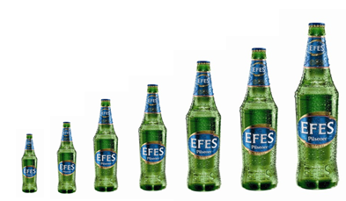
ANADOLU EFES
Anadolu Efes started its production and sales operations in Turkey with two beer factories that had a total capacity of 300.000 hectoliters and became the market leader in the 80’s.
Anadolu Efes has annual production capacities of 43.7 million hectoliters of beer and 293,656 tons of malt.
43.7 Million hectoliters
0.3 Million hectoliters
1969
2012

Slide 6
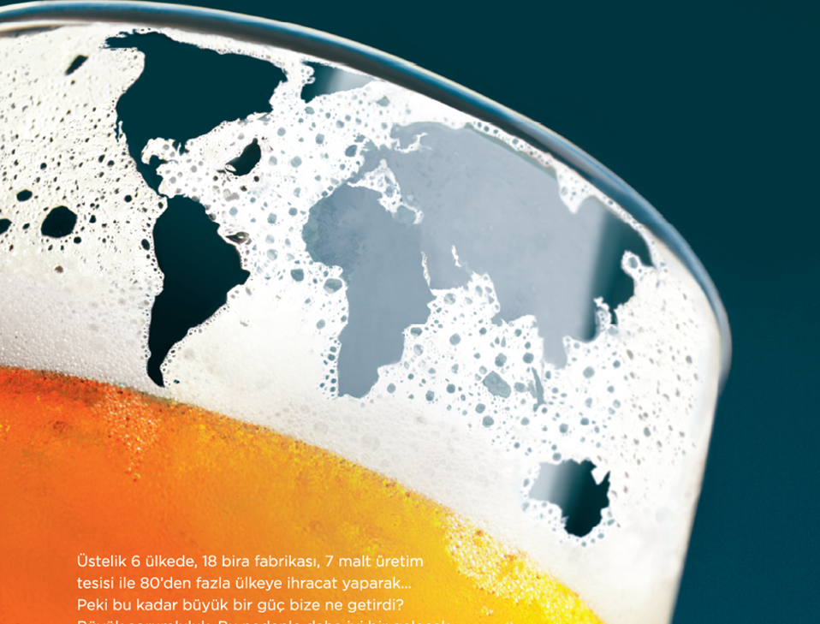
Anadolu Efes became today 5th largest brewer in Europe and 11th largest brewer in the World
Anadolu Efes is market leader in Turkey, Kazakhstan, Georgia and Moldova

Slide 7
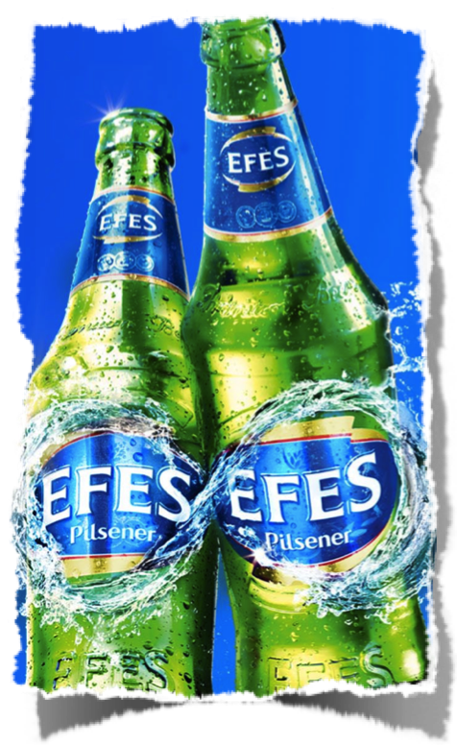
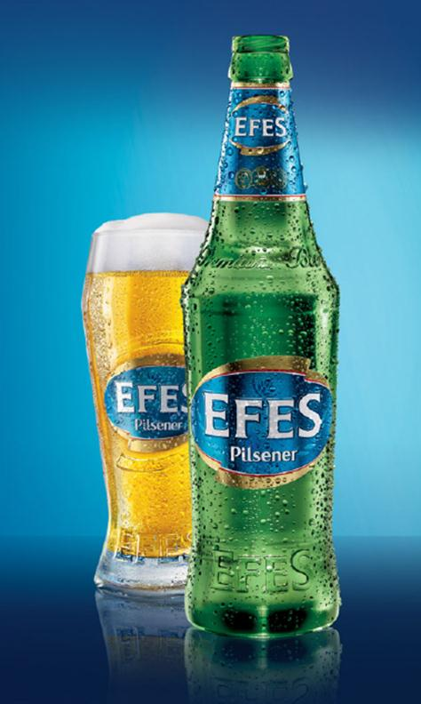
EFES PILSENER -THE BRAND
The flagship brand of Efes Anadolu, Efes Pilsener is the high-quality lager with 5% alcohol content, brewed by bottom fermentation technique with selected hops and barley. The beer has a refreshing, well-balanced smooth taste and easy drinking character.

Slide 8
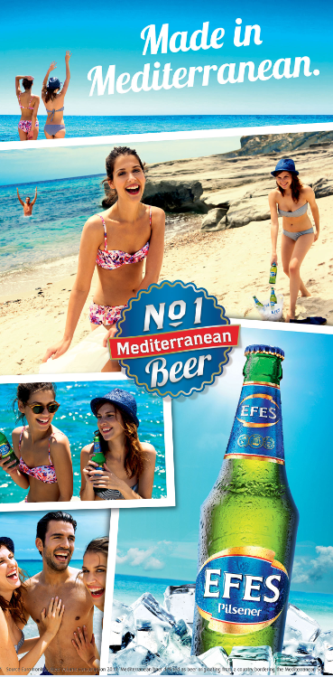
EFES PILSENER
“The ‘real’ Mediterranean ”
As coming from Mediterranean and being the most consumed Mediterranean beer in the world* , only Efes can provide you with the ‘Real’ Mediterranean experience:
Target audience: 18-30 year old young men who just moved into a world of financial independence. They are actively engaging with life, sociable, lively, friendship centered, fun & entertainment oriented, quietly confident. They try to find little escapes from life’s boring side.
* Source: Euromonitor; Beer Volume consumption 2011
warm, funny, spontaneous, relaxed
Efes Pilsener is consumed with appreciation in more than 80 countries.

Slide 9
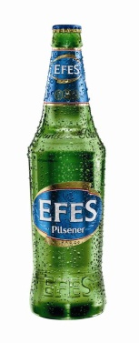


EFES PILSENER
Numerous awards in international contests are testament to the quality and
Efes Pilsener
Year of 1973
Gold Medal
Selection Mondial Paris
Year of 1996
Bronze Medal
World Beer Cup
Year of 1979
Gold Medal
Golden Caraius 19th Caralious
Year of 1983
Golden Medals
Medalla de ore Alacalidad Internacional Bebidas Aliocoholicas Madrid
Madrid International Quality Contest
22nd Rome Beer and Non-alcoholic Drink Selection
Year of 1981,
1996, 2002, 2006,2013
Gold, Silver and Bonze Medals
Monde Selection Bruxelles

Slide 10
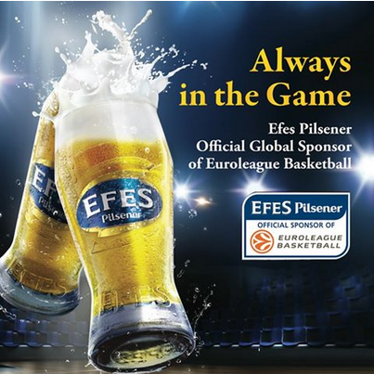
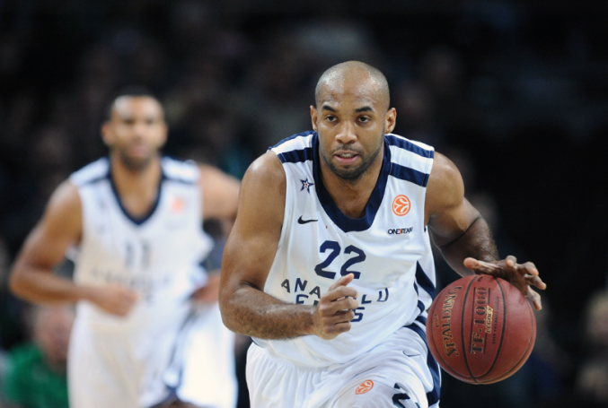
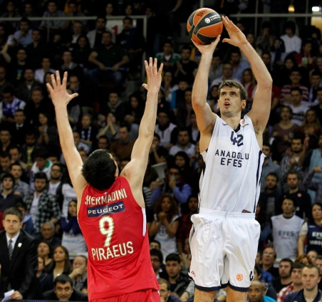
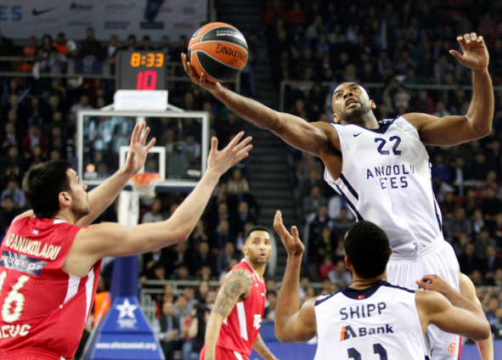
EFES PILSENER - EUROLEAGUE BASKETBALL
Anadolu Efes is proud to contribute to the life of its consumers in a positive way .The company supports several sports activities in all its markets.
Anadolu Efes Sports Club has been founded in 1976 and is Turkey’s most successful professional basketball team for over 30 years.
Anadolu Efes is also a proud sponsor of European basketball through Euroleague; the most important professional club basketball competition in Europe, with teams from up to 18 different countries.

Slide 11
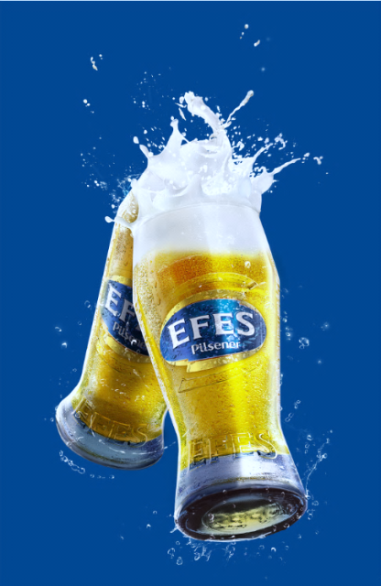
BEVERAGE GROUP

