Slide 1

EVER DRINK KFT.
SALES FOR COMMERCIAL CHAIN
2013

Slide 2
United Brands: Metro, Auchan 302 hl / year
SPAR 597 hl / half year
SPAR: estimated sale for next year 900 hl
BUT SPAR DURING 6 MONTHS !!!

Slide 3
SOLD HL / MONTH
United Brands: 25 hl
SPAR: 100 hl

Slide 4

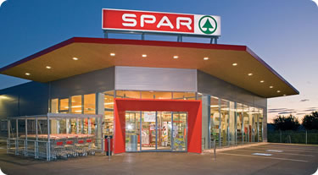


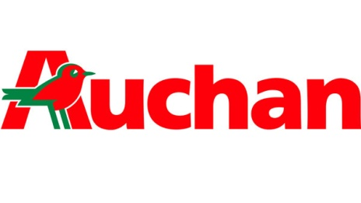
SPAR IS BETTER – WHY?
Our sales managers:
control stores, product outplacement, marketing tools
personal relations with the store/department manager
we can supervise actions
Average action price (inc.tax) : 299 Ft
UNITED BRANDS (Metro, Auchan)
Average action price (inc.tax) : 360 Ft

Slide 5
Expecting market background 2014
SPAR: negotiation of price in progress
Increase is impossible!!!
United Brands: increase is necessary, BUT
United Brands will contact direct from Paulaner
We need market protection!!!

Slide 6
Our request from Paulaner in 2014
2000 EUR from Paulaner + 2000 EUR from Ever Drink Kft. for marketing support / commercial chain
Support of actions
Advertisement in the paper
Secondary placement
2. After solding products: 10 % (now) + 5 % support in goods

Slide 7
Our plans for 2014 in case of Paulaner support
SPAR : 100 % growth
Distribution increasing
High season: supply to new hipermarkets with bigger purchasing power
/ CBA, COOP, RONI /
We will supply direct to Metro / Auchan
(first year we will keep the turnover of United Brands and dynamic increase after next year)

Slide 8
Thank you for your attention!

