Slide 1
Our Paulener story
Our Paulaner story

Slide 2
Legacy
Turnover 2011 / 3344Hl
Drinktec and Ever Drink
Share of commercial chains rose from below 5% to 37%

Slide 3

Our goal, and plans at the start.
To do or best:
efficient brand and customer management, marketing policy
low operating costs, low margin
flexibility
professional service
tailored conditions for clients
Building the market, and the PAULANER brand!
And earn much money ..)

Slide 4
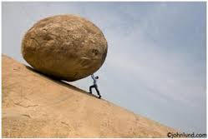
Since than…
We worked hard…very hard
We pumped back almost all of our profit into our business.
Technical and marketing equipment for new partners worth of about 95.000EUR
Marketing activities for about 40.000EUR
Activities in the commercial chains for about 25.000EUR
Thanks for your support!!!!

Slide 5
hard work result..
2013 : complete Hungarian imported premium beer market sales about 20.642 hl
2013 Ever Drink market share almost 25% (4725 hl)
We could extend our sales by almost 40% from 3344 hl to 4714 hl over the last two years

Slide 6

Our original plans for 2014
To lean back in the chair and to harvest the fruit of our hard work, what we did in the last 3 years!

Slide 7
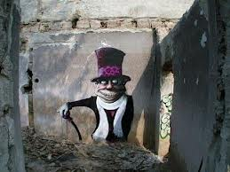
But what happened!
The Pécs brewery, as an internal rival, ruined it what we built up till now!
Our clients do not understand the market situation, they became uncertain.

Slide 8
What is expected in 2014?
Pécs
hardball
bad pricing policy
Market
Partners become uncertain
Lower and lower prices
Results
Turnover falling
Bad brand reputation
Because of Pécs:
We lost most of our profit margin at the commercial chains.
We can’t support the activities at the commercial chains!
Level of sales volume: questionable
Margin falling in the Horeca by min. 10% due to price competition
We won’t be able to deliver directly to METRO, AUCHAN,TESCO due to the special market situation

Slide 9

consequences.
2014.- our yearly plans are upset anyway.
Turnover
Profit margin
What should we do?

Slide 10
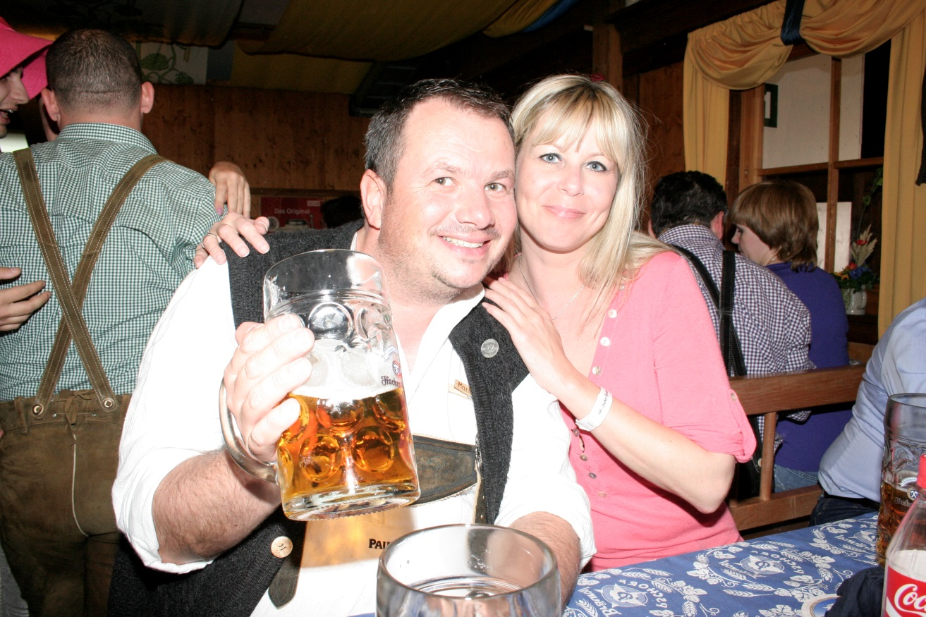
solution
First of all!!!
To drink much more PAULANER
Then:
Building the market and the PAULANER brand together, without PÉCS
With product range extension reducing our operating cost.
To restore the business confidence
To try to raise the prices
To support the market with the 10000-10000 EUR, as we agreed earlier.

Slide 11
Exactly…
Our turnover in the commercial chains / Hl
Increased by 100%
Only in the last year

Slide 12
Activities and fees
activities | Metro fees | AUCHAN fees | nr.in Metro | nr.in Auchan | Total marketing spending
post / flyer | 450EUR / Store | 0EUR/Store | 3 | 2 | 1350
secondary placement | 167EUR/Store | 83EUR/Store | 13 | 19 | 3748
listing | 2333EUR/EAN | 333EUR/EAN |  | 3 | 999
Tasting / stores | 50EUR | 50EUR | 13 | 19 | 1600
in-out | 0 EUR | 0 EUR | 4 | 3
METRO 13 stores |  |  |  |  | 7697
Auchan 19 stores
SPAR refund 10% / 900HL turnover |  | about 12280EUR
TESCO refund 10%/200HL turnover |  | about 3200EUR
 |  | 15480EUR |  |  | TOTAL 23177EUR

Slide 13
For example: expense distribution Spar
Promotion start | end | Product | post flyer | Promotion price | second.placm.
08.mav | 14.may | Hacker-Pschorr BV, one way 0,5 lit. 3 kind | yes | yes | yes
29.may | 04.jun | PAULANER Brazil KIT | yes |  | yes
26.jun | 02.jul | Paulaner 0,5l can beer WB and OM | yes | yes | yes
07.aug | 13.aug | Paulaner 0,5l can beer WB and OM |  |  | yes
21.aug | 27.aug | Hacker-Pschorr BV, one way 0,5 lit. 3 kind |  |  | yes
18.sept | 24.sept | 0,5l- Okt fest can beer | yes | yes | yes
13.nov | 19.nov | Winter HWD Set | yes |  | yes

Slide 14
Summarizing the most necessary steps:
-Market building together, without Pécs
-Market support / commercial chains /23.177 EUR / share 50-50%
-To increase our competitiveness with product range extension
-product range extension with your agreement, and to sell much more PAULANER with better profit!

Slide 15

...and to earn much money..

